Slide 1

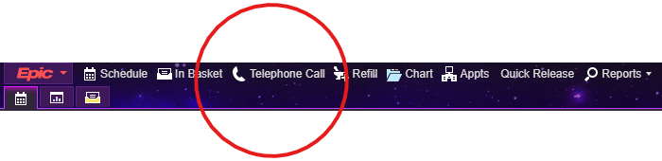
PRIOR AUTHORIZATION TIP SHEET
STEP BY STEP INSTRUCTIONS ON HOW TO COMPLETE AND DOCUMENT PRIOR AUTHORIZATION REQUEST
Review the chart. Look for and open encounter regarding the PA. If a telephone encounter has not been opened start a new telephone encounter.

Slide 2
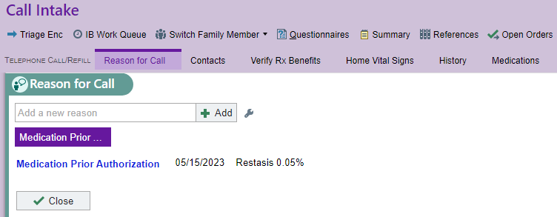
2. Be sure to add reason for call as Medication Prior Authorization and the name of the medication in details.
Search medication prior authorization. I normally type in Prior and hit enter to find it.
Select Medication Prior Authorization and hit enter.
Under details type in the name of the medication.

Slide 3
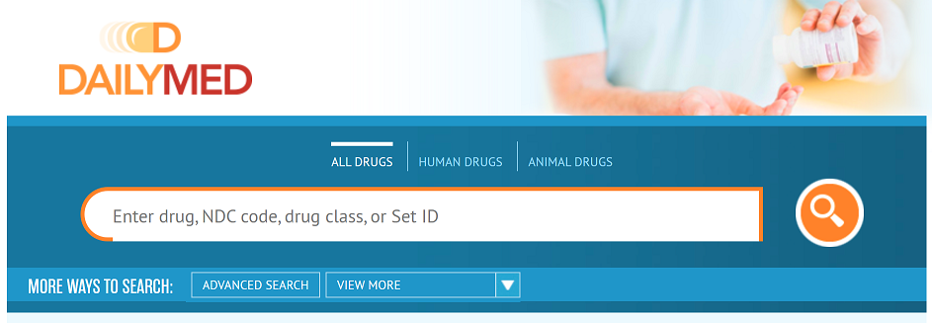
3. Please be sure to review the medical records and why the physician is prescribing. If you’re not familiar with the medication I recommend going to: https://dailymed.nlm.nih.gov/dailymed
You’ll find the FDA approved diagnosis and how the medication is used. Please review or reach out to me via Jabber, Epic Instant message or text me at
(336)684-3736 if you have any questions.

Slide 4
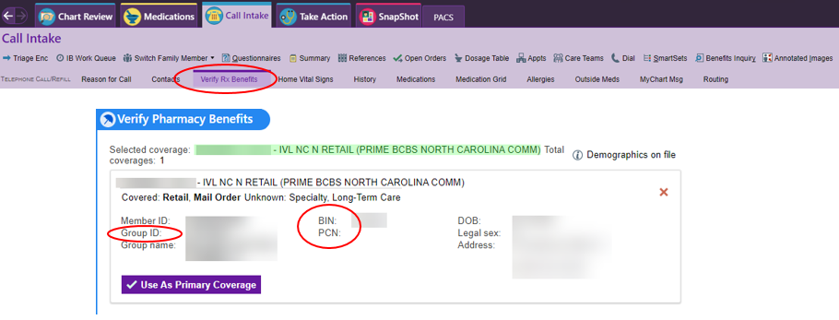
4. Don’t have a cover my meds key?
Within the telephone encounter you’ll find a tab for verify RX benefits. Once you’ve click on that tab that will give all the information needed to start a PA without a cover my meds key. You’ll plug in the BIN, PCN and Group into cover my meds.
Pro-tip:
Be sure to enter in the patient’s as it appears in the Verify Pharmacy Benefits section. For example if there’s a suffix like JR, SR, MD or etc. listed on the RX benefits the suffix needs to go with the last name to verify eligibility.

Slide 5
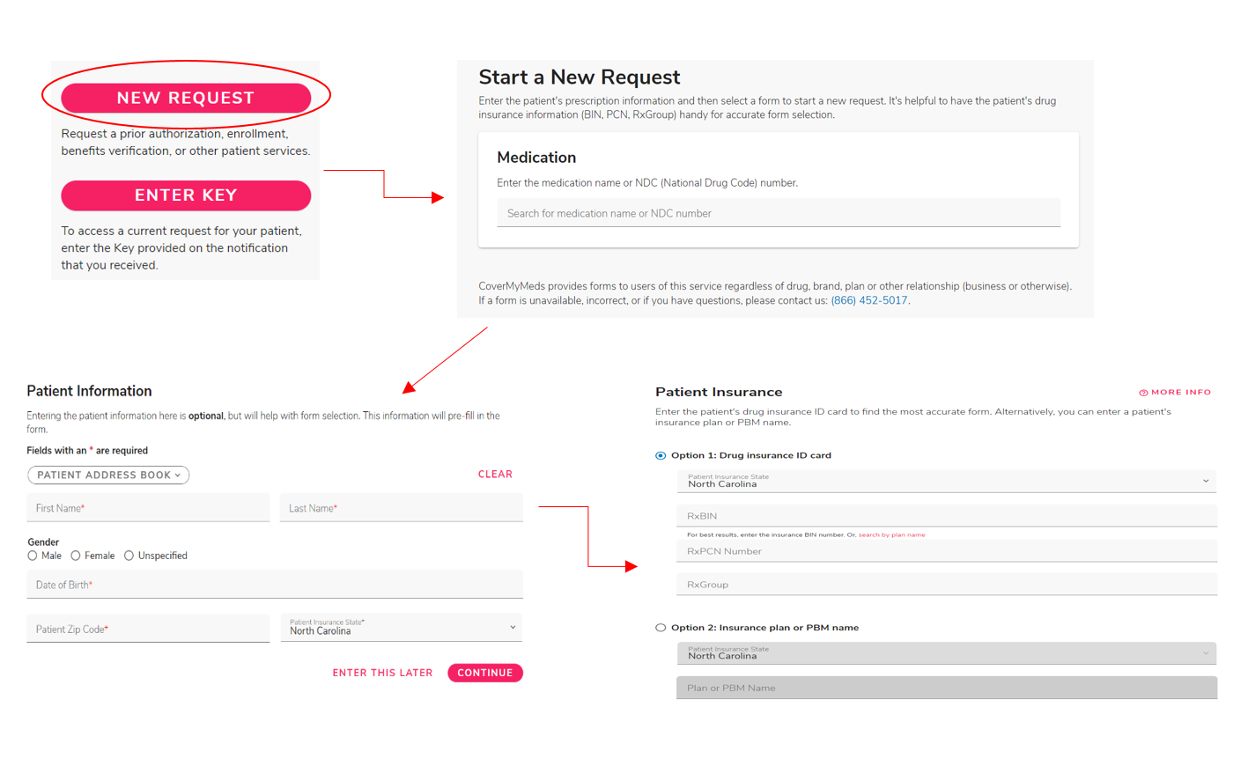
5. Once logged into cover my meds go to new request. That will take you to where you add the drug name. Then you’ll add the patient’s preliminary information such as name, DOB and zip code. That will take you to selecting the pharmacy benefit manager information. I recommend add the RXBIN, PCN and group fully as will most likely narrow down your option to the exact form.

Slide 6
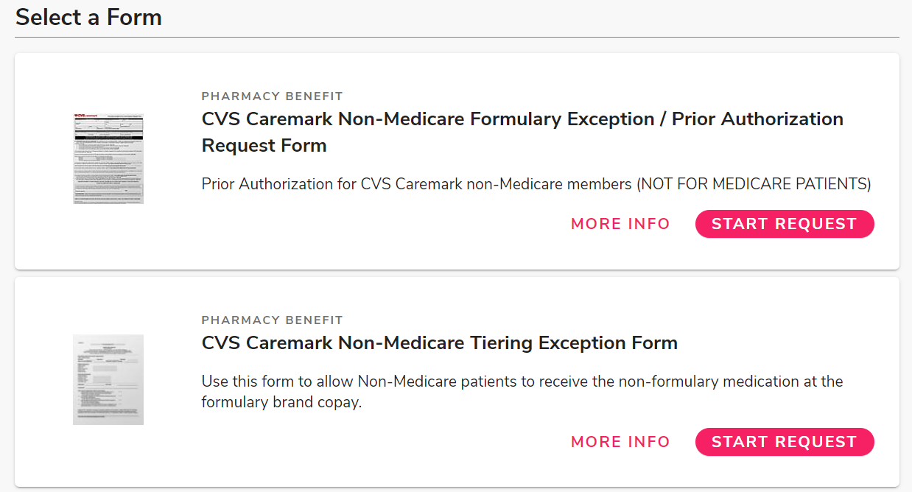
6. Here’s an example of the forms that you may see based upon the search. The tier exception from is only used to reduce the cost of medications. The prior authorization form and the tier exception for are NOT interchangeable. Select start request once you see the desired form and complete all fields of the PA request.

Slide 7
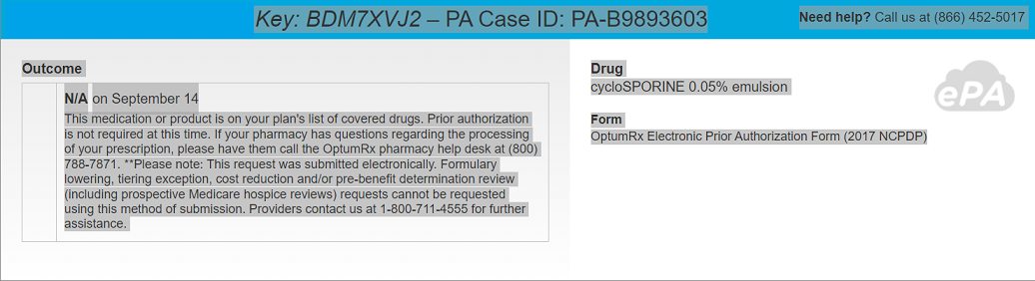
7. Once the PA has been submitted highlight the entire header in cover my med and right click to copy. Then paste under the under the documentation within the telephone encounter you’ve opened.

Slide 8
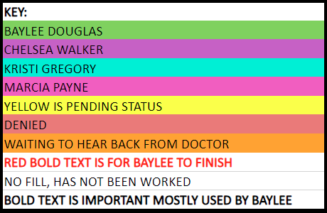
9. Please log the PA request on the shared spreadsheet. This will help prevent double work. Select a fill color that that is not being use to signify your work. Please review the key at the top of the each week’s spreadsheet to signify your work.

Slide 9
Things to keep in mind
Not all insurances recommend using cover my meds.
Tricare: does not recommend using cover my meds. You will find the Tricare formulary search tool at https://www.express-scripts.com/frontend/open-enrollment/tricare/fst/#/. When searching the medication there’s a link to the PA form. Please familiarize yourself to the questions that will asked and call Tricare at 866.684.4488.
***TRICARE DENIALS CAN TAKE UP TO 90 DAYS TO APPEAL***
If we don’t have the clinical data to support the claim it’s best to discuss with the physician first before proceeding with the PA. I always review Tricare’s form but will call in the PA because they give an instant approval over the phone. If you call in the PA please be sure to get the case ID number and effective dates.
NC Medicaid: (Not including managed Medicaid) please check the preferred drug list at: medicaid.ncdhhs.gov/nc-medicaids-preferred-drug-list-pdl-sept-1-2023/download?attachment.
Trial and failure of two Preferred drugs are required unless only one Preferred option is listed or is otherwise indicated. Not all therapeutic drug classes are included on the PDL. All drugs in the classes not included are considered Preferred. In addition to trial and failure criteria, clinical criteria (indicated in RED) may also apply. New to market products typically default to Non-Preferred status until reviewed by the PDL Panel. These drugs are listed as TO BE REVIEWED. Drugs requiring prior authorization, clinical criteria and prior authorization request forms can be found at: https://www.nctracks.nc.gov/content/public/providers/pharmacy.html More information on the PDL can be found at: https://medicaid.ncdhhs.gov/providers/programs-services/prescription-drugs/outpatient-pharmacy-services. Please check and see if the patient meets the criteria prior to calling the PA in at 800.688.6696. Medicaid can be more complicated and it maybe best to leave these for Baylee, marking it in bold red on the spreadsheet and add a note NC Medicaid. This includes Medicaid managed care.
If you happen to start a PA in CMM and it appears they will be faxing the PA to the insurance please stop and mark it bold red for Baylee to finish. The indicator for CMM to fax is if they give the phone and fax on the form being completed.

